Slide 1

SCSA1304
ADVANCED DATA STRUCTURES
B.E CSE 2019-2023
III SEMESTER
VIRTUAL CLASS ROOM
UNIT III
GRAPHS
.

Slide 2
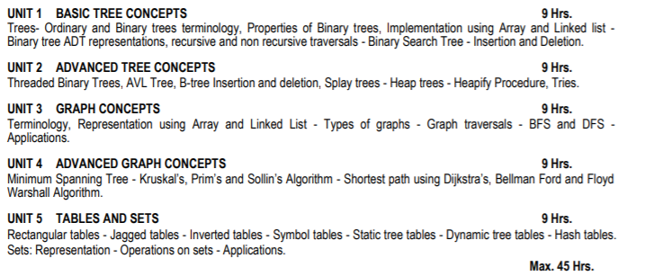

SCSA1304
ADVANCED DATA STRUCTURES

Slide 3
GRAPHS
It is similar to the trees. But graph have enclosed loop.
Graph is defined as set of (V,E) pairs.
Where,
V = Vertices
E = Edges
Vertices is represented as circles. Also known as nodes
Edges is represented as lines. Connecting two vertices.
A
B
C
A,B,C = Vertices (Data Elements)
(A,B) (A,C) (B,C) = Edges
A,B,C = Vertices
(A,B) (A,C) (B,C) = Edges
A
B
C
A,B,C,D,E,F = Vertices
(A,B) (A,E) (B,E) (D,E) (E,F) (C,F) = Edges
D
E
F

Slide 4
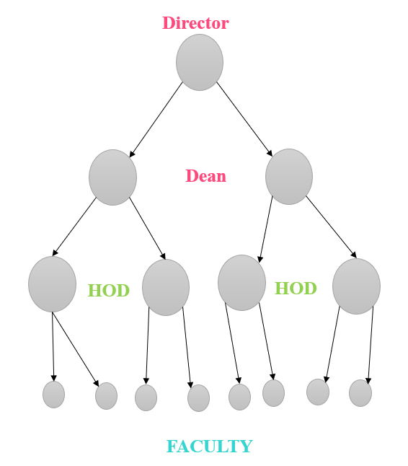
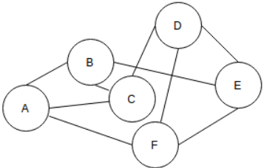
TREE | GRAPH
Only one path between two nodes | More than one path is allowed between two nodes
Starting node will be available | No starting node
Does not have any loop ( Uni directional) | Have loop
Hierarchy | Network
All trees are graph | All graphs are not tree
No cycle | Cycle

Slide 5
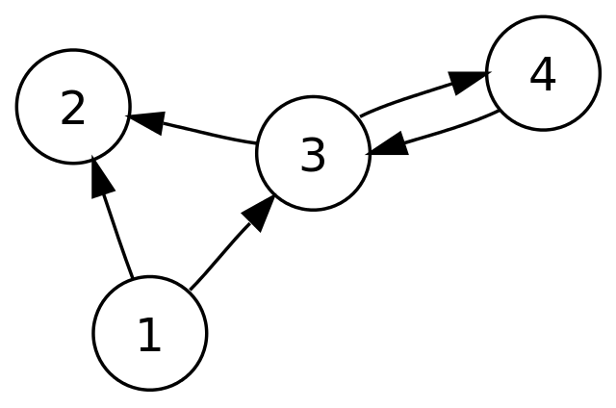
ALL TREES ARE GRAPH BUT ALL GRAPHS ARE NOT TREE
A connected acyclic graph is called a tree. In other words, a connected graph with no cycles is called a tree.
Trees Comes into the category DAG – Directed Acyclic Graph is a kind of directed graph with no cycle.
Graph can be either cyclic or acyclic

Slide 6
TYPES OF GRAPH
Directed Graph
Undirected Graph
Weighted Graph
Unweighted Graph
Directed Graph: (Diagraph)
A directed graph is graph, i.e., a set of objects (called vertices or nodes) that are connected together, where all the edges are directed from one vertex to another. A directed graph is sometimes called a digraph or a directed network.

Slide 7
TYPES OF GRAPH
Undirected Graph: (Bidirectional)
An undirected graph is graph, i.e., a set of objects (called vertices or nodes) that are connected together, where all the edges are bidirectional. An undirected graph is sometimes called an undirected network. In contrast, a graph where the edges point in a direction is called a directed graph.

Slide 8
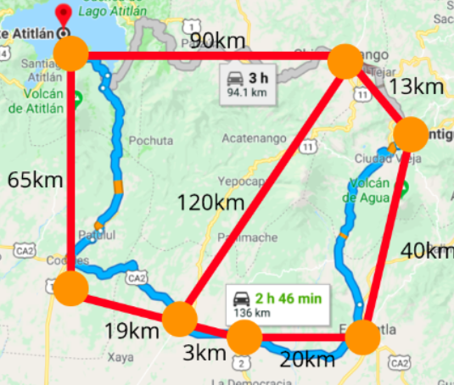
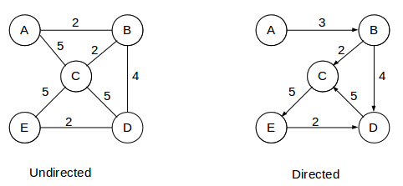
TYPES OF GRAPH
Weighted Graph:
A weighted graph refers to one where weights are assigned to each edge.
Weighted graphs can be represented in two ways:
i) Directed graphs where the edges have arrows that show path direction.
ii) Undirected graphs where edges are bi-directional and have no arrows.

Slide 9
TYPES OF GRAPH
Weighted Graph:
Example:
Distance between:
A to C in Undirected graph is 5
E to D in Directed graph is 2

Slide 10
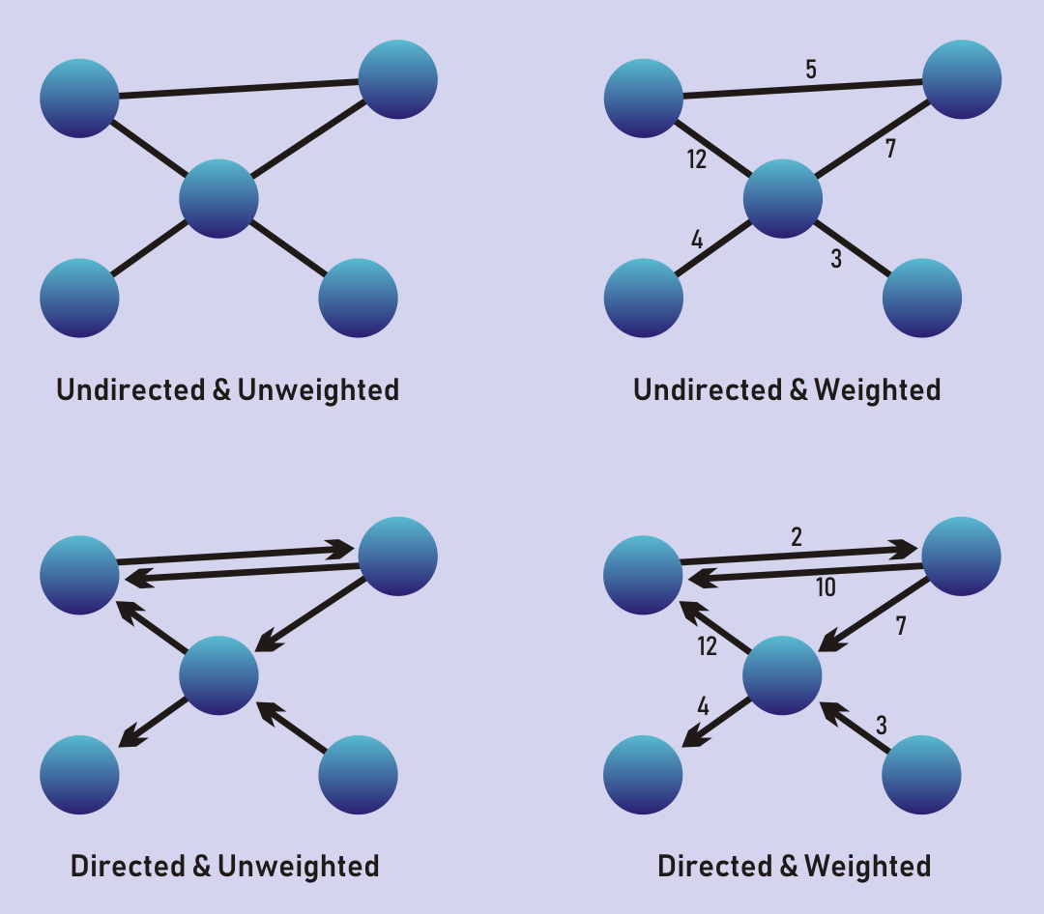
TYPES OF GRAPH
Unweighted Graph:
If the edges do not have weights, the graph is said to be unweighted. Edges simply show connections

Slide 11
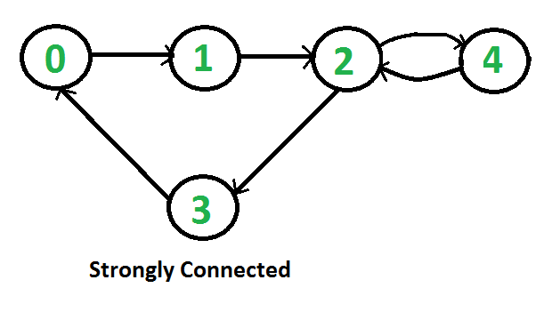
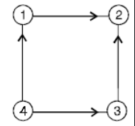
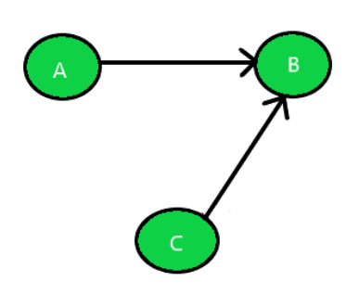
v
u
Reachable: If there is a path from u to v then v is reachable from u (i.e) v -> u = 2 -> 3
Strongly Connected Graph | Unilaterally Connected Graph / Unilateral | Weakly Connected Graph / Not Strongly Connected Graph
In directed graph, a graph is said to be strongly connected if every vertex is reachable from every other vertex | If it contains a directed path from u to v or v to u for every pair of vertices u,v. | A graph is said to be weakly connected if there doesn’t exist any path between any two pairs of vertices.
Every pairs of point are mutually reachable | At least for any pair of vertices, one vertex should be reachable form the other | A directed graph is weakly connected if it is underlying graph (means graph without direction) is connected

Slide 12
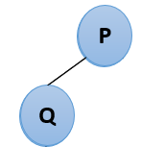
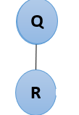
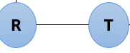
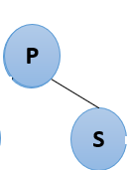
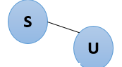
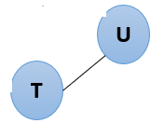
Terminology of Graph
Node: Vertices or circle which contain data or elements
Edge: A line connection between two nodes
Adjacent Node: Connects two neighbour nodes
Degree of Node: Number of Edges Connected to that node
P
P
P, Q, R, S, T, U
Q
S
Q
U
{(P,Q) (Q,R) (R,T) (T,U) (P,S) (S,U)}
R
T
Degree of P is 2
Degree of S is 2
Degree of Q is 2
Degree of R is 2
Degree of T is 2
Degree of S is 2
Degree of U is 2

Slide 13
Terminology of Graph
Size of Graph: Total number of edges in a graph
Path: Sequence of vertices from source node to destination
Arc: The directed edge in a directed graph is called an arc
P
2
6
Number of edges or path in the given graph = 6
Q
S
7
U
3
R
T
5
Ex: Source = P and Destination = T
Path = P -> Q -> R -> T, P -> S -> U -> T
4

Slide 14
Terminology of Graph
Arc: A directed edge in a directed graph called arc.
Out degree: The number of arcs exiting from the node is called out degree of that node.
In degree: The number of arcs entering the node is called in degree of that node
Node | In degree | Out degree
1 | 0 | 2
2 | 2 | 0
3 | 1 | 2
4 | 1 | 1

Slide 15
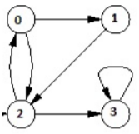
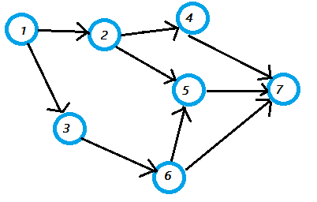
Terminology of Graph
Source Node: A node where the indegree is 0 but has a positive value for outdegree is called a source node. That is there are only outgoing arcs to the node and no incoming arcs to the node.
Example: Node 1
Sink Node: A node where the outdegree is 0 and has a positive value for indegree is called the sink node. That is there is only incoming arcs to the node and no outgoing arcs the node.
Example: Node 2
Cycle/Cyclic: A cycle in a directed graph is a directed path that originates and terminates at the same node ie some number of vertices connected in a closed chain.
Acyclic: A graph which does not have any cycle
A graph contain three cycle such as 0->2->0, 0->1->2->0 and 3->3

Slide 16
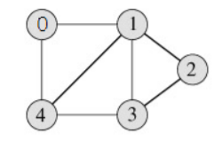
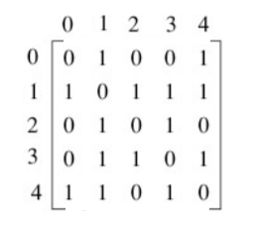
Representation of Graph
Adjacency Matrix
Using Multi Dimensional Array
Using List
Incidence Matrix

Slide 17
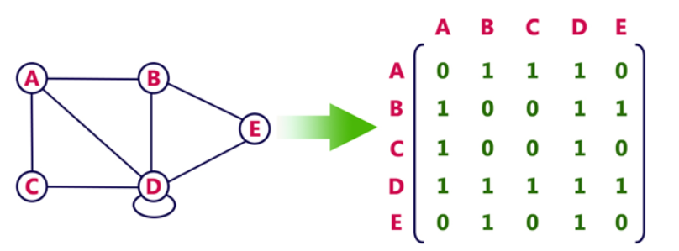
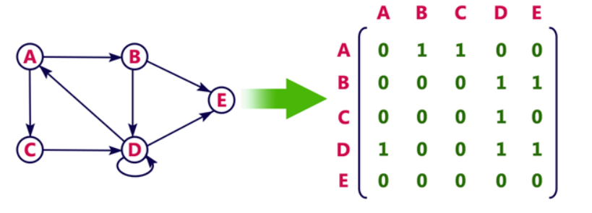
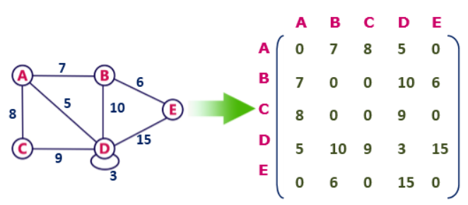
Representation of Graph
Multi Dimensional Array - Adjacency Matrix / Sparse Matrix :
Adjacency matrix is a sequential representation
It is used to represent which nodes are adjacent to each other. i.e. is there any edge connecting nodes to a graph.
In this representation, we have to construct a nXn matrix A. If there is any edge from a vertex i to vertex j, then the corresponding element of A, a^{i},^{j} = 1, otherwise a^{i},^{j}= 0.
Undirected | Directed | Undirected Weighted
Advantage: Representation is easier to implement and follow. Disadvantage: It takes a lot of space and time to visit all the neighbors of a vertex (traverse all the vertices in the graph)

Slide 18
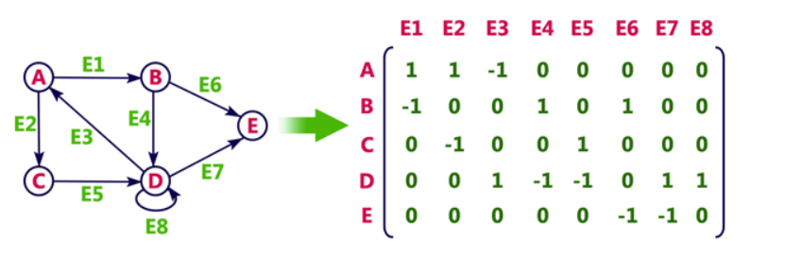
Representation of Graph
Multi Dimensional Array – Incidence Matrix :
In Incidence matrix representation, graph can be represented using a matrix of size:
Example: If a graph has 4 vertices and 6 edges, then it can be represented using a matrix of 4X6 class.
Where,
i) columns = edges
ii) rows = vertices
This matrix is filled with either 0 or 1 or -1. Where,
0 is used to represent row edge which is not connected to column vertex.
1 is used to represent row edge which is connected as outgoing edge to column vertex.
-1 is used to represent row edge which is connected as incoming edge to column vertex.
IM = Total no. of Vertices X Total no. of Edges

Slide 19
Representation of Graph
List/ Adjacency List:
Adjacency list is a linked representation.
In this representation, for each vertex in the graph, we maintain the list of its neighbors (Every vertex of the graph contains list of its adjacent vertices)
An array of vertices which is indexed by the vertex number and for each vertex v, the corresponding array element points to a singly linked list of neighbors of v.
A:
B:
C:
D:
B
D | X
B
A
D
C | X
A
C
B
D | X
D
A
B | X
C | X
B
A:
B:
C:
D:
B
D | X
A
C
C | X
D
D | X
B | X

Slide 20
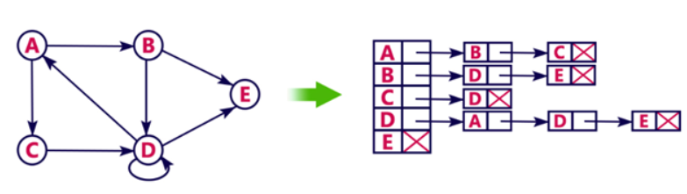
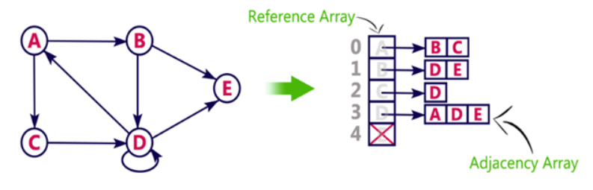
Representation of Graph
Advantages:
Adjacency list saves lot of space.
Easily insert or delete
Disadvantages:
The adjacency list allows testing whether two vertices are adjacent to each other but it is slower to support traversal path operation.

Slide 21
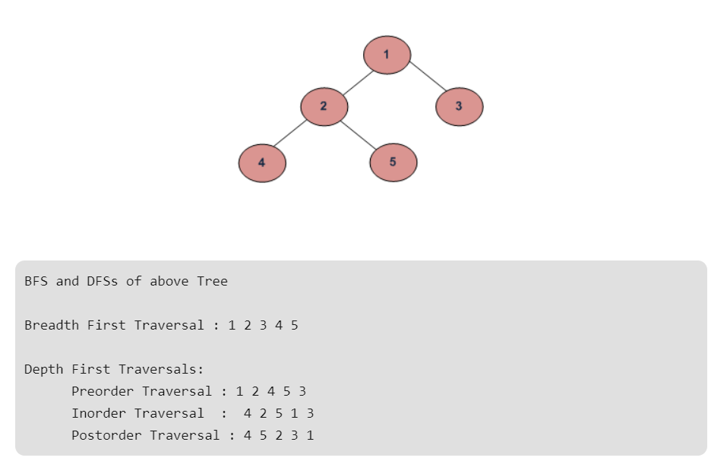
(Recall – UNIT 1) BREADTH FIRST SEARCH AND DEPTH FIRST SEARCH IN BINARY TREE
A Tree is typically traversed in two ways:
Breadth First Traversal (Or Level Order Traversal)
Depth First Traversals
Inorder Traversal (Left-Root-Right)
Preorder Traversal (Root-Left-Right)
Postorder Traversal (Left-Right-Root)

Slide 22
GRAPH TRAVERSAL
Graph traversal is a technique used for a searching vertex in a graph.
The graph traversal is also used to decide the order of vertices is visited in the search process.
A graph traversal finds the edges to be used in the search process without creating loops.
There are two graph traversal techniques and they are as follows,
DFS (Depth First Search)
BFS (Breadth First Search)
Visiting a Vertex
Exploration of Vertex
Visiting a Vertex
Exploration of Vertex
Depth First Search | Breadth First Search
Start from any node. Explore that node. Repeat for all the node. | Any one as a starting node. Any order can visit.
Ex: 1,2,3,6,7,4,5 | Ex: 1,2,4,5,7,3,6
5
4
7
6
5
4
7
6
5
4
7
6
5
4
7
6
5
4
7
6
5
4
7
6
5
4
7
6
1
2
3
1
2
3
1
2
3
1
2
3
1
2
3
1
2
3
1
2
3
5
4
7
6
5
4
7
6
5
4
7
6
5
4
7
6
5
4
7
6
5
4
7
6
1
2
3
1
2
3
1
2
3
1
2
3
1
2
3
1
2
3
5
4
7
6
5
4
7
6
1
2
3
1
2
3

Slide 23
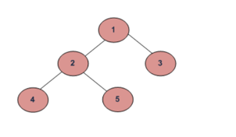
Breadth First Search
1 2 3 7 6 4 5
6
7
6
7
6
7
6
7
6
7
6
7
6
7
6
7
Depth First Search
6
7
6
7
6
7
6
7
6
7
6
7
4 2 5 1 3 7 6
6
7

Slide 24
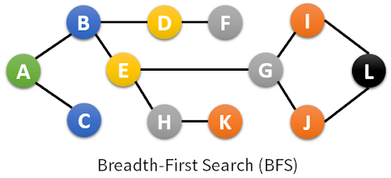
Breadth First Search – Undirected Graph
D | F | B | A | E | C | G | H | I | J | K | L
D F B A E C G H I J K L

Slide 25
Breadth First Search – Directed Graph
A
C | F | G | E | D | B | A
B
F
C
D
G
E
C F G E D B A
A
A
A
A
B
C
F
A
B
C
F
B
B
C
F
B
C
F
C
F
D
E
G
G
D
G
D
G
D
G
D
E
E
E
E
A
A
B
C
F
B
C
F
D
G
D
E
G
E

Slide 26
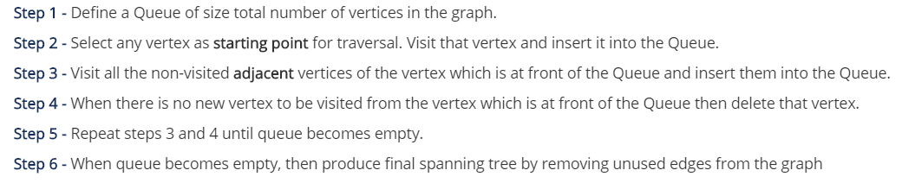
GRAPH TRAVERSAL
Breadth First Search:
BFS traversal of a graph produces a spanning tree as final result.
Spanning Tree is a graph without loops.
Queue data structure with maximum size of total number of vertices in the graph to implement BFS traversal.

Slide 27
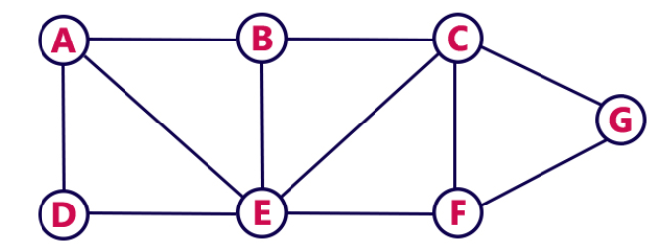
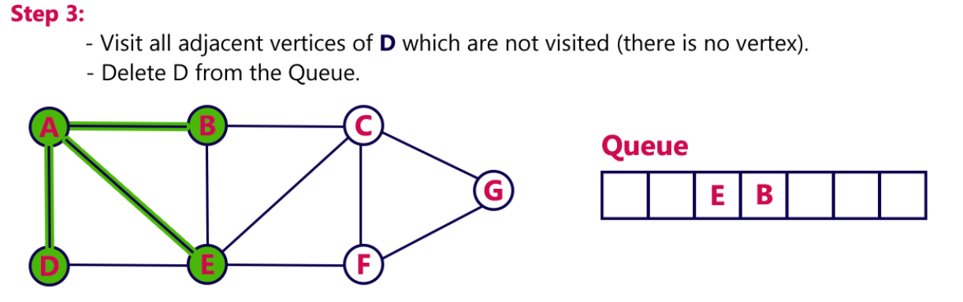
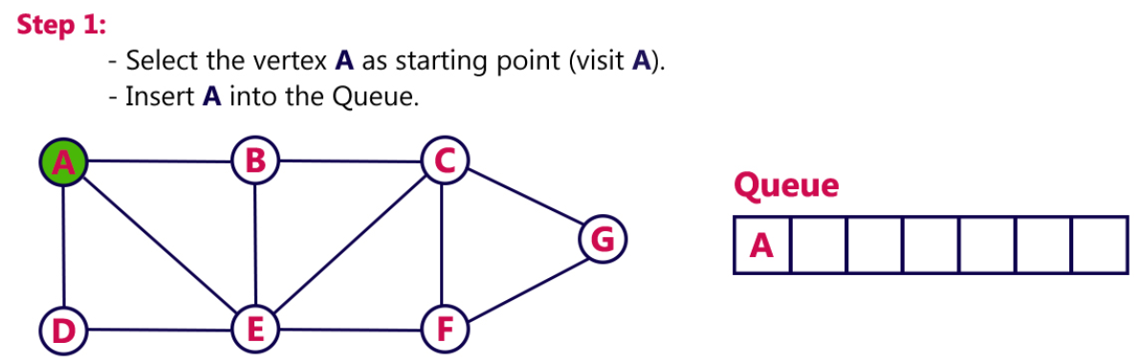
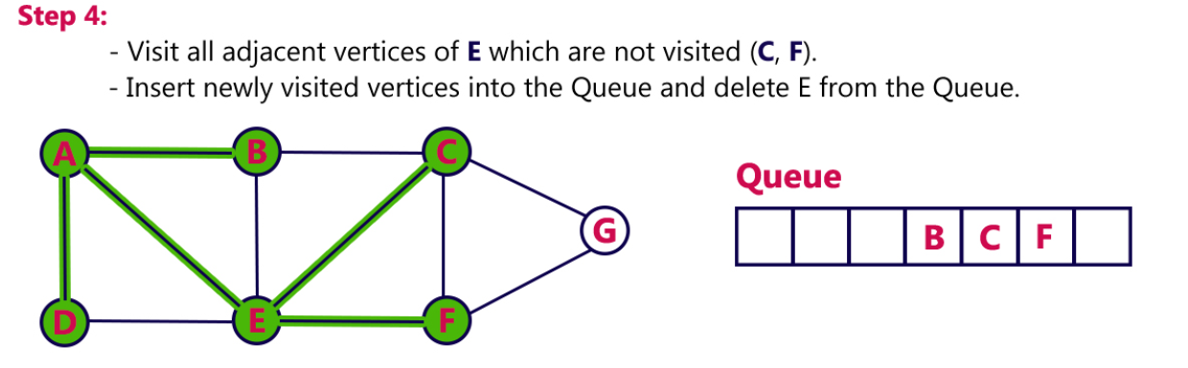
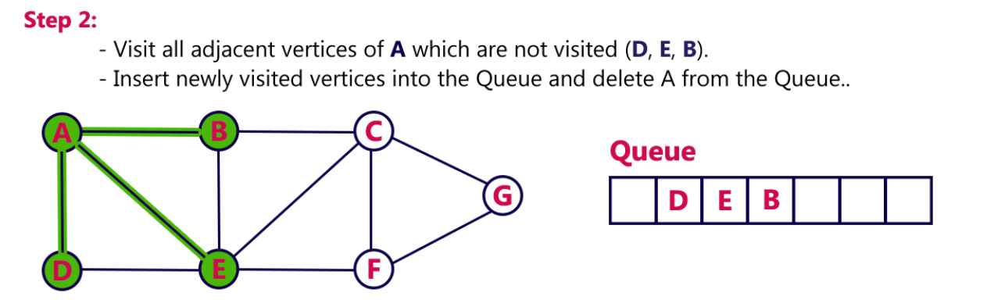
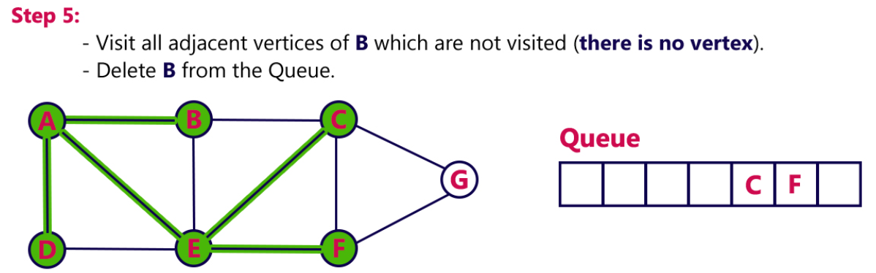

Slide 28
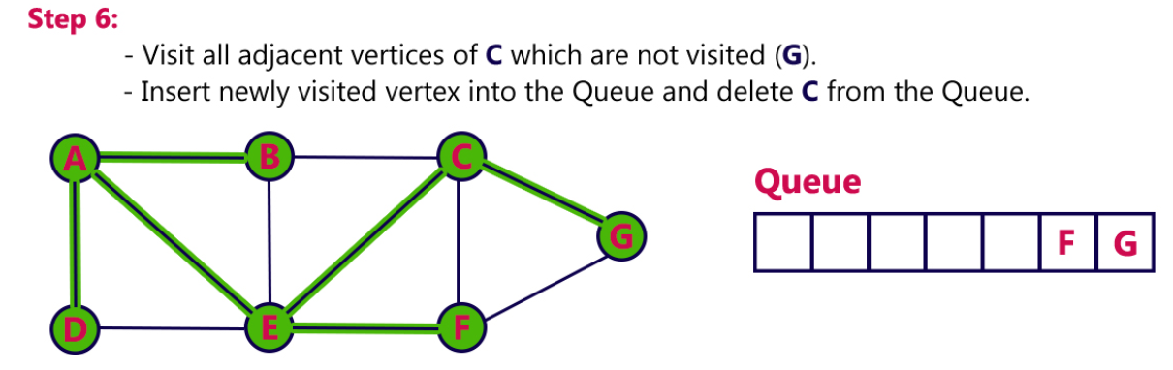
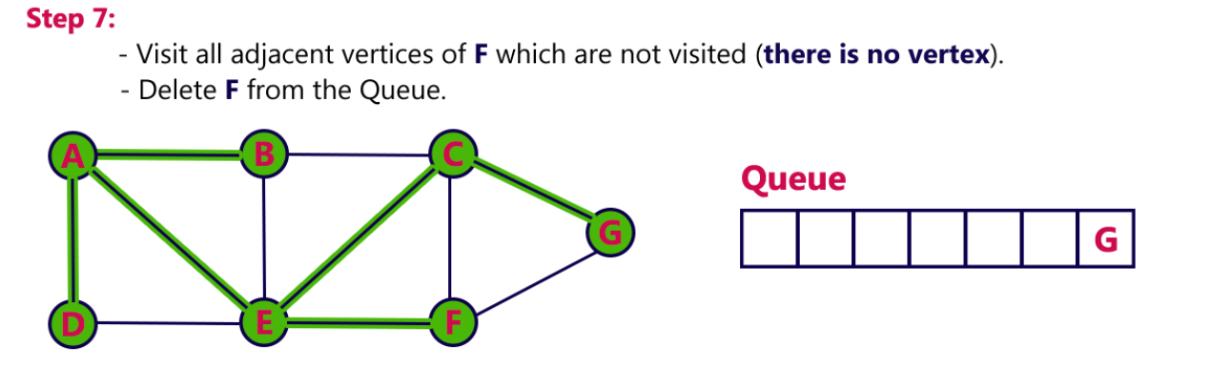
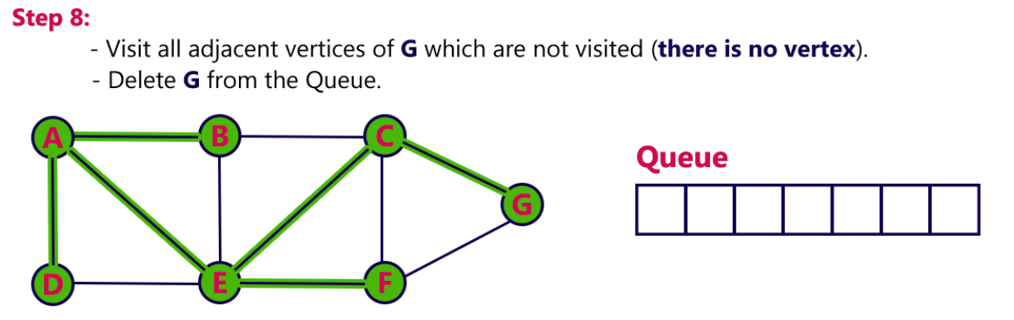

Slide 29
APPLICATION OF BFS
Shortest Path and Minimum Spanning Tree for unweighted graph In unweighted graph, the shortest path is the
path with least number of edges. With Breadth First, we always reach a vertex from given source using minimum number of edges. Also, in case of unweighted graphs, any spanning tree is Minimum Spanning Tree and we can use either Depth or Breadth first traversal for finding a spanning tree.
2) Peer to Peer Networks: In Peer to Peer Networks like BitTorrent, Breadth First Search is used to find all neighbor nodes.
3) Crawlers in Search Engines: Crawlers build index using Breadth First. The idea is to start from source page and follow all links from source and keep doing same. Depth First Traversal can also be used for crawlers, but the advantage with Breadth First Traversal is, depth or levels of built tree can be limited.
4) Social Networking Websites: In social networks, we can find people within a given distance ‘k’ from a person using Breadth First Search till ‘k’ levels.
5) GPS Navigation systems: Breadth First Search is used to find all neighboring locations.
6) Broadcasting in Network: In networks, a broadcasted packet follows Breadth First Search to reach all nodes.

Slide 30
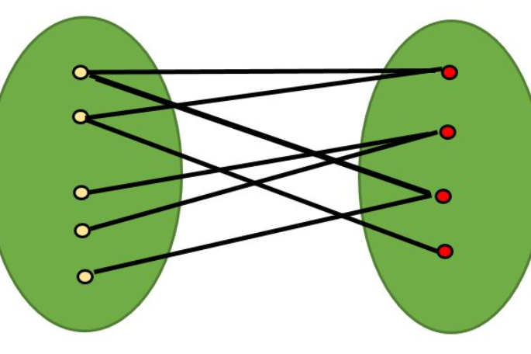
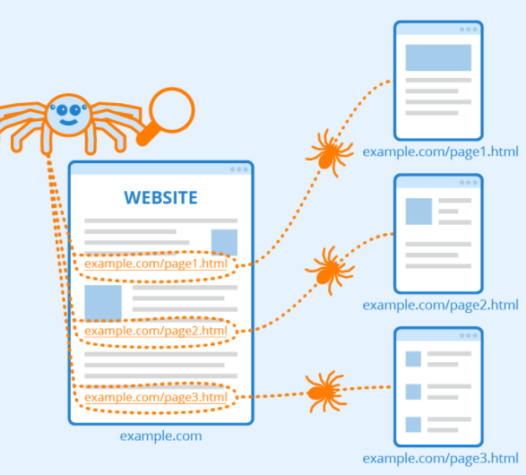
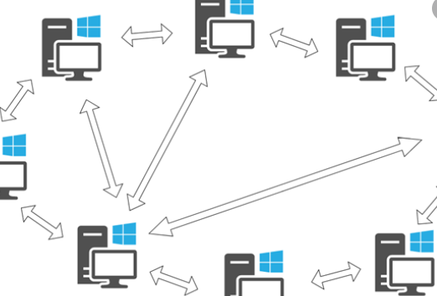
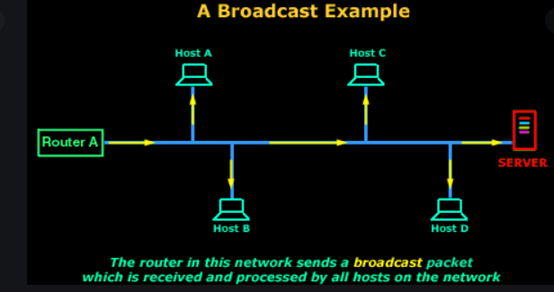
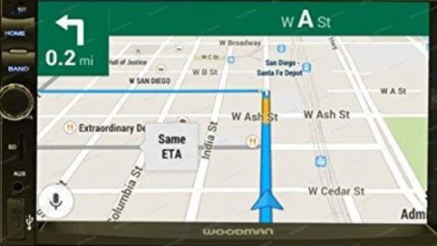

Slide 31
APPLICATION OF BFS
7) Cycle detection in undirected graph: In undirected graphs, either Breadth First Search or Depth First Search can be used to detect cycle. In directed graph, only depth first search can be used.
8) Ford–Fulkerson algorithm In Ford-Fulkerson algorithm, we can either use Breadth First or Depth First Traversal to find the maximum flow. Breadth First Traversal is preferred as it reduces worst case time complexity to O(VE2).
9) To test if a graph is Bipartite We can either use Breadth First or Depth First Traversal.
10) Path Finding We can either use Breadth First or Depth First Traversal to find if there is a path between two vertices.
11) Finding all nodes within one connected component: We can either use Breadth First or Depth First Traversal to find all nodes reachable from a given node. Many algorithms like Prim’s Minimum Spanning Tree and Dijkstra’s Single Source Shortest Path use structure similar to Breadth First Search.

Slide 32
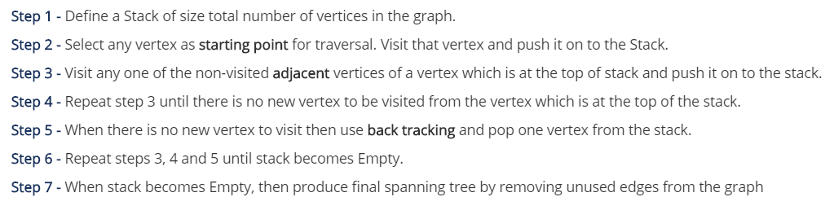
GRAPH TRAVERSAL
Depth First Search:
DFS traversal of a graph produces a spanning tree as final result.
Spanning Tree is a graph without loops.
We use Stack data structure with maximum size of total number of vertices in the graph to implement DFS traversal.

Slide 33
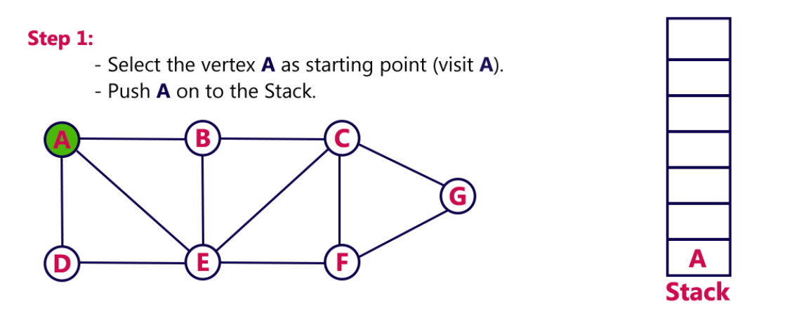
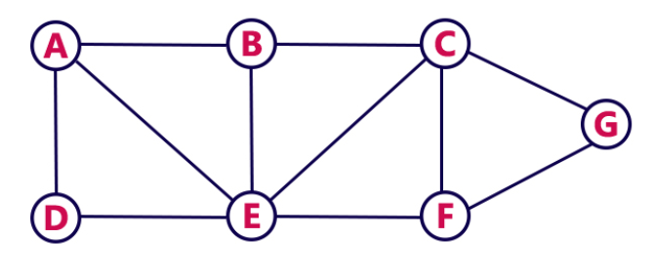
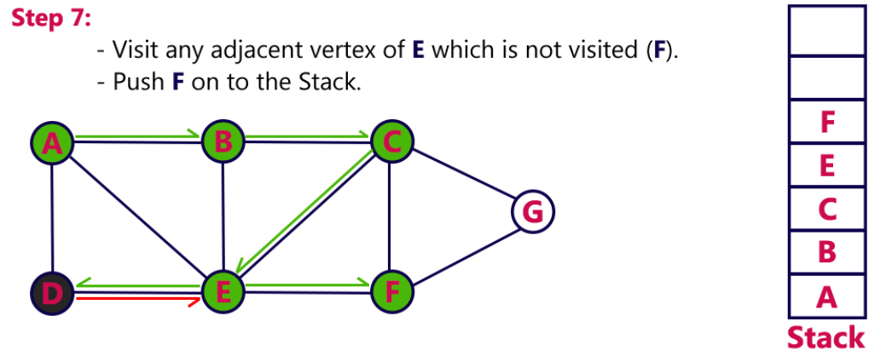
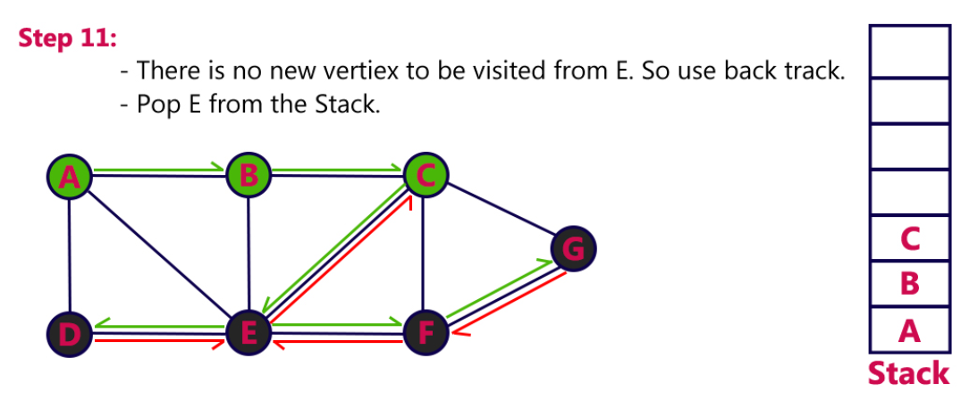
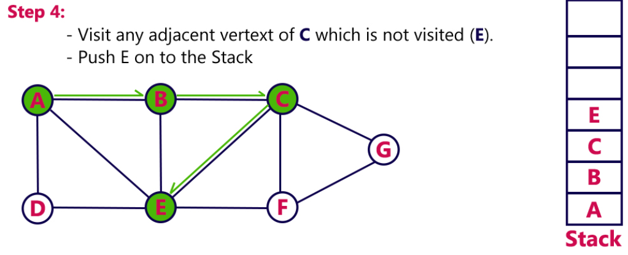










Slide 34


Slide 35
APPLICATION OF DFS
1) For an unweighted graph, DFS traversal of the graph produces the minimum spanning tree and all pair shortest path tree.
2) Detecting cycle in a graph :
A graph has cycle if and only if we see a back edge during DFS. So we can run DFS for the graph and check for back edges.
3) Path Finding:
DFS algorithm to find a path between two given vertices u and z.
i) Call DFS(G, u) with u as the start vertex.
ii) Use a stack S to keep track of the path between the start vertex and the current vertex.
iii) As soon as destination vertex z is encountered, return the path as the contents of the stack
4) Topological Sorting:
Topological Sorting is mainly used for scheduling jobs from the given dependencies among jobs.
In computer science, applications of this type arise in instruction scheduling, ordering of formula cell evaluation when recomputing formula values in spreadsheets, logic synthesis, determining the order of compilation tasks to perform in make files, data serialization, and resolving symbol dependencies in linkers .
5) Finding Strongly Connected Components of a graph A directed graph is called strongly connected if there is a path from each vertex in the graph to every other vertex.
6) Solving puzzles with only one solution, such as mazes. DFS can be adapted to find all solutions to a maze by only including nodes on the current path in the visited set.

